Slide 1
The Environmental Modification Accountability Act
ClimateViewer.com/enmod/

Slide 2
An idea who’s time has come!
WEATHER WARFARE IS ILLEGAL
The United Nations ban on hostile environmental modification techniques was signed in 1978 at the ENMOD Convention.
This law makes weather modification, geoengineering, ionospheric heating, and spraying chemicals (like defoliants) illegal only if the intent is hostile.
WEATHER WARFARE IS UNDETECTABLE
When the United States’ CIA became concerened about Russia tampering with American weather in 2015 they called Alan Robock and asked ‘would we know?’ He stated that we “probably would.”
Earlier in 2015, Dian Seidel (NOAA) definitively stated that we cannot tell the difference between natural and man-made clouds.
(20th Conference on Planned and Inadvertent Weather Modification)
We demand transparency and accountability from the Rainmakers, Climate Changers, and Weather Warriors.

Slide 3



Weather Warfare Major Players
China
USA
Russia

Slide 4
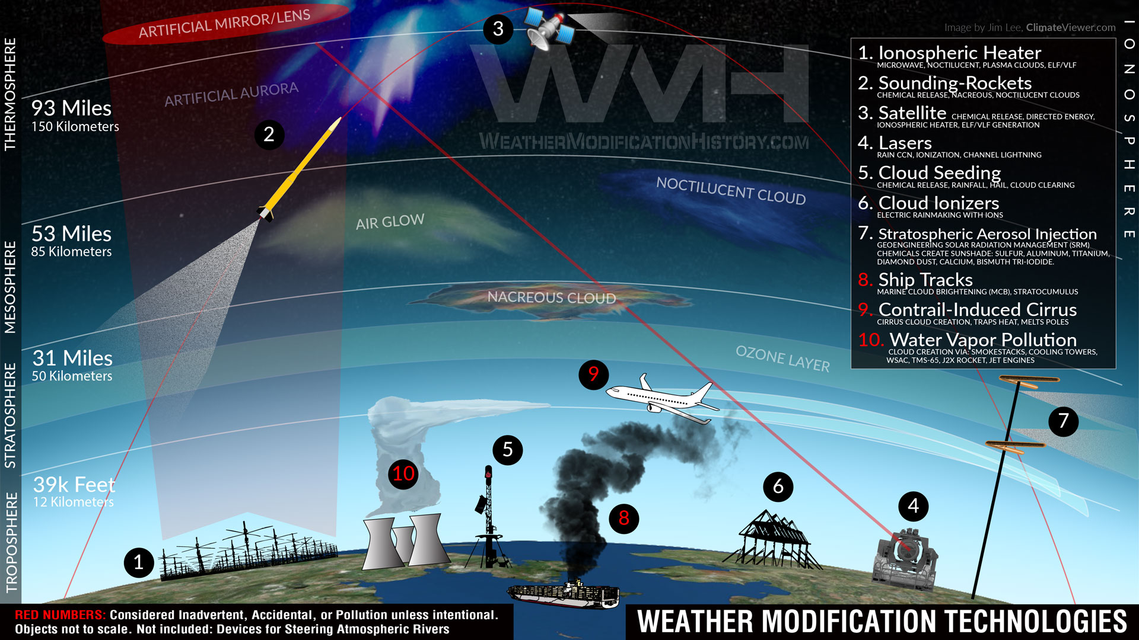
Weather
Warfare
Tools & Tech

Slide 5
hello!
I am Jim Lee
I help people understand complex ideas by creating maps, timelines, articles, and lectures.
You can find me at @climateviewer

Slide 6
I want to help you understand the problem
TRANSPARENCY
How can we determine if an individual or organization is engaged in hostile actions if they are not required to explain their intentions or give public notice before experimenting in our skies?
VERIFICATION
How can we catch ENMOD violators without the proper tools to do so?
If we catch violators, who enforces sanctions/penalties?

Slide 7
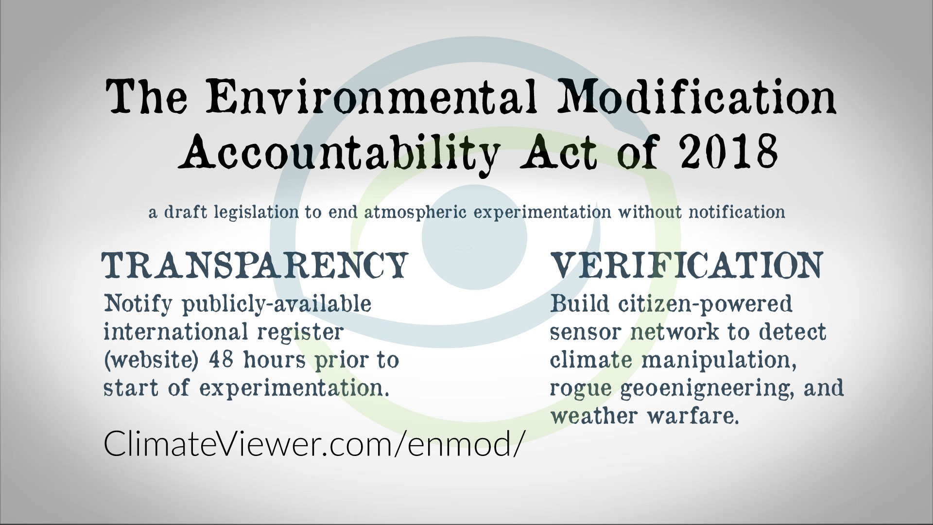

Slide 8
1.
Transparency
“To be hostile, or not to be…”

Slide 9
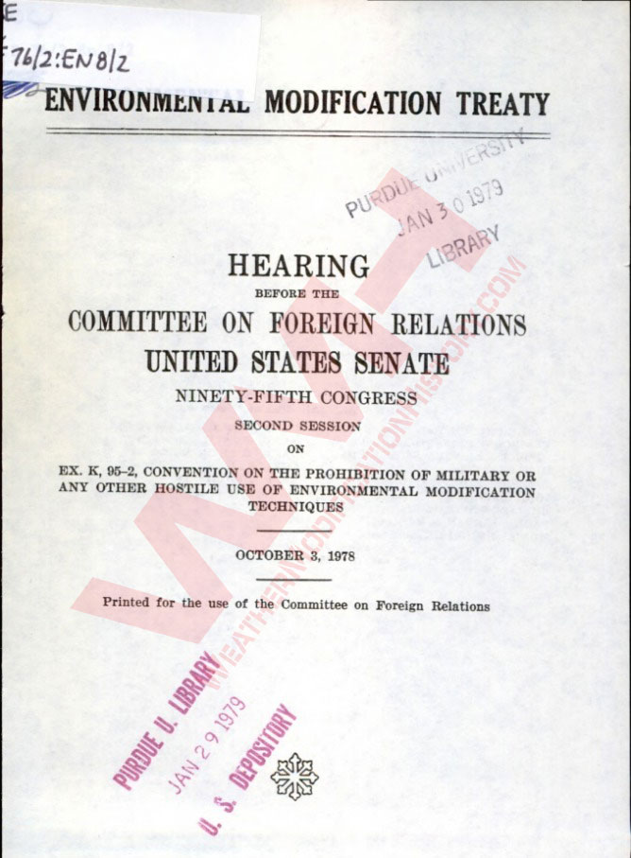
A World-Wide Weather Modification Registry
REQUIRE: Minimum 48 hour notice of intention to experiment in the atmosphere: cloud seeding, ionospheric heating, weather modification, etc.
State purpose, location, etc.
REGISTRY IS ALWAYS AVAILABLE ON INTERNET, UPDATED HOURLY.

Slide 10
TRANSPARENCY MATTERS
Public has a right to know
Improve accuracy of weather and climate prediction models
Examine butterfly effects of hundreds of simultaneous experiments
Accountability for environmental, physical, or monetary loss from both legal and clandestine weather modification.
If an individual or organization engages in weather modification activities without notifying the registry (at least) 48 hours before:
MAY BE CONSIDERED HOSTILE & BASED SEVERITY, ENMOD VIOLATION.

Slide 11
Why not just ban weather modification altogether?

Slide 12
Why Banning Weather Modification is unlikely
BANS DO NOT WORK
Above-ground nuclear warhead testing is illegal due to the Limited Test Ban Treaty, YET North Korea tests nuclear warheads.
Best case: build sensors to catch bad actors… more details on that in the Verification section of this presentation.
TOO BIG TO FAIL
Weather modification is over a century old and is a multi-billion dollar industry. Stock markets and insurance companies bet on weather and ensure their bets pay off with this technology.
Water-strapped States will not give up this technology.
HUMANS CONTROL
Unfortunately, it is in our nature to control everything: land, rivers, and oceans. Why would the sky be any different?
Though I would prefer no weather modification at all, men shall dare in the name of progress.
Therefore we need transparency.

Slide 13
Transparency is a start!
Transparency may result in public outrage or acceptance. We need to start with disclosure.
Knowing is half the battle…

Slide 14
2.
Verification
“Trust but verify”

Slide 15
ENMOD has no TEETH!
PROBLEM
If we have a global registry of “legitimate” weather modification experiments, AND we want to catch bad actors, how do we detect clandestine/military/secret programs?
SOLUTION
Combine atmospheric sensors worldwide into one super weather warfare detection system. (similar to nuclear monitoring by the CTBTO’s International Monitoring System)
Augment that sensor network with a second, CITIZEN-POWERED observational network!

Slide 16
ClimateViewer
A Citizen-Powered Earth Observing
Sensor Network
[ in your backyard ]

Slide 17
What is a Sensor?
DEFINITION: a device that detects or measures a physical property and records, indicates, or otherwise responds to it.
Sensors are senses for robots: taste, sight, touch, smell, and sound.
Light sensors, wind sensors, geiger counters, video cameras, spectrometers, and radio antennas are just a few examples of common sensors.

Slide 18
Decentralized IoT Network
ClimateViewer will connect people, robots, and sensors together to display their data in many ways: Graphs, Timelines, Maps, etc.
ClimateViewer is open-source. ClimateViewer will rely on Netention to gather sensor data and store it on block chain and Interplanetary File System (IPFS). User and sensor data is distributed on a load-balanced network securely, privately, and indefinitely.

Slide 19
15,400,000,000
In 2015, there were about 15.4 billion connected [IoT] devices. According to IHS, this number will grow to 30.7 billion in 2020, and 75.4 billion by 2025.
Wearable devices are also noticeably growing. From 28.3 million units sold in 2016, IDC forecasts an increase to 82.5 million units in 2020, a 31 percent growth.
13 stunning stats on the Internet of Things
LET’S PUT THEM TO WORK!

Slide 20
Live Streaming Atmospheric Data
 | Records | Uptime | Rating
Rain Samples | 1,089 | 85% | 99%
All Sky Camera | 32,420 hours | 100% | 100%
Aerosol Samples | 23.589 | 72% | 85%

Slide 21
Real-time Sensor Map
ClimateViewer #1

Slide 22
ClimateViewer Sensor Network Benefits
Act as a verification regime in parallel with a separate government-backed sensor network.
Combat censorship of “official” sensor data by creating a dataset with no centralized control. [ Think ClimateGate ]
Gather priceless observational data that will improve all atmospheric sciences, let alone, catch bad guys.
Prevent further loss of life from acts of Terrorism. Help first responders to biological and radioactive aerosols, dirty bombs.
Accountability for environmental, physical, or monetary loss from both legal and clandestine weather modification.

Slide 23
The ENMOD Accountability Act
HOW IT WORKS
Require Notice
Registry
Catch Bad Guys
Sensors
No Fear
That’s You!
ClimateViewer.com/enmod

Slide 24
Let’s review some concepts
Weather Warfare Is Illegal
The Environmental Modification Convention (ENMOD), formally the Convention on the Prohibition of Military or Any Other Hostile Use of Environmental Modification Techniques, was signed in 1978.
Geoengineering is Banned
The Convention for Biological Diversity placed a moratorium on large scale geoengineering experiments in 2012. The USA did not sign this agreement.
Bans Do Not Work
The only thing that matters is proof. Knowing is half the battle, the rest can usually be settled in court! We have the technology, let’s see the evidence. We need to know that storms are not man-made!
48 Hour Public Notice
This is a monumental change to disclosure of atmospheric experimentation and will create accountability for weather modification.
ClimateViewer Sensor Network
Combining every publicly available IoT sensor and creating our own specialized local ClimateViewer for your backyard to track flights, boats, watch your sky, and VERIFY who’s controlling your weather!
Amendment to ENMOD
The ENMOD Accountability Act is a draft legislation and is intended to be written into law and enforced because it is necessary for the safety of humanity.

Slide 25
“Unless someone like you cares a whole awful lot, nothing is going to get better. It’s not!” – Dr. Seuss, The Lorax

Slide 26
thanks!
Any questions?
You can find me at
ClimateViewer.com ● ClimateViewer.org
WeatherModificationHistory.com
jim@climateviewer.com

Slide 27
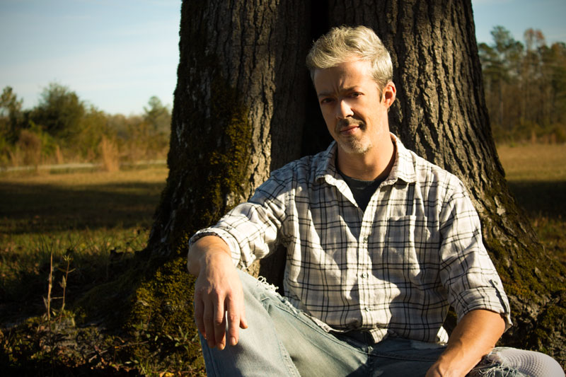
Credits
This presentation created by Jim Lee is free to distribute and is considered Public Domain. Please share this solution, support my work, and we will see clarity and transparency in the hidden world of climate engineering. https://climateviewer.com/geoengineering/
This file will be hosted at: https://climateviewer.com/enmod/
Please do not modify this file. If you want to help support my efforts please donate:
https://www.paypal.me/climateviewer
https://www.gofundme.com/climateviewer
Special thanks to SlidesCarnival for this awesome PowerPoint template.

